Slide 1
Transformation Temple International Church
Revised special use permit application
Case Number: #SUP2020-00019

Slide 2
BACKGROUND
International Central Gospel Church began in 2003 in Springfield, Virginia, Fairfax County.
After nearly 17 years, the Church is ready to find a permanent home in Prince William County.
75% of their members live in Prince William County.
The church purchased the property at 5451 Davis Ford Road the 2019.
The congregation currently has 120 members.
The name of the church in Woodbridge will be Transformation Temple International Church.
Services on Sundays from 10 am to 12 pm.; Wednesdays from 7 pm to 8 pm; and Fridays from 7 pm to 9 pm.

Slide 3
PROPERTY INFORMATION
Request - This is a special use permit request to allow for a religious institution.
Property size: ± 4.3 acres.
Site Location – The address is 5451 Davis Ford Road. The subject property is 1.5 miles northwest of Prince William Parkway.
Zoning - The site is currently zoned A-1, Agricultural.
Religious institution uses are permitted in the A-1 zoning district with a special use permit.
Comprehensive Plan - The subject site is designated SRR, Semi-Rural Residential.
Religious institution uses consistent with the SRR designation.

Slide 4
Plan Comparison
Old development Plan
Current Development Plan

Slide 5
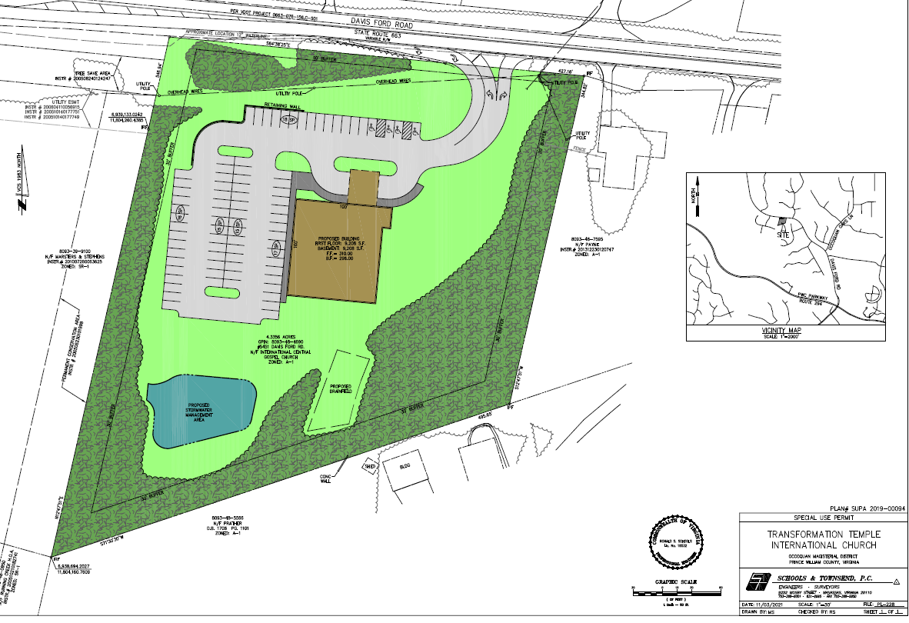

Slide 6
CONCERNS AND RESPONSES
Concern: Phase I and Phase II Development
Removed Phase II (i.e., 9900 square foot structure)
Concern: Indoor Youth Center and Gymnasium
Removed gymnasium or recreational center.
Concern: VDOT Right of Way/Parking Area
Purchased the VDOT right of way to facilitate parking spaces.
Concern: Lot size
Increased from 3.7 acres to 4.3 acres.
Concern: Entrance to the property within the 30-foot buffer
Relocated the entrance so that it is outside of the 30-foot buffer and farther away from the property line.
Concern: Congregation size
Reduced the number of seats in the sanctuary from 250 seats to 208 seats; reduces traffic coming to the site.

Slide 7
CONCERNS AND RESPONSES
Concern: Parking Spaces
Reduced parking spaces along Davis Ford Road from 38 spaces to 18 spaces
Reduced parking spaces along west side of property from 85 spaces to 63 spaces.
Reduced the total number of parking spaces from 123 spaces to 81 spaces.
Included a 10-foot buffer and retaining wall between the parking lot and Davis Ford Road.
Concern: Noise
30-foot buffer with existing trees on the west, south and east sides of property.
Sound mitigation system within the church.
Concern: Existing Trees
Retain existing trees in the 30-foot buffer area and provide additional planting in the buffer area.
Retain the existing trees on the northwest side of the property abutting Davis Ford Road.
Concern: Church building - color and dimensions
Changed the exterior color of structure (i.e. brick color).
Proffer not to exceed 34 feet tall.

Slide 8
CONCERNS AND RESPONSES
Concern: Stormwater Management
Stormwater Management Pond on site
Proffer to meet all legal and regulatory requirements
Concern: Water/Sewer
Connecting the public water main on Davis Ford Road.
Septic Drain field installation.
Proffer to meet all legal and regulatory requirements.
The Health Department has not expressed any concerns regarding the drain field.
Concern: Police
Prince William County - Central District Station at 5036 Davis Ford Road – 2 minute travel time.
Concern: Fire and Rescue
Fire/Rescue Station 26 (Bacon Race) – within 4-minute travel time (Basic Life Support); 8-minute travel time (Advanced Life Support).

Slide 9
CONCERNS AND RESPONSES
Concern: Traffic
The PWC Department of Transportation is requesting a left turn lane for Phase I/II Development Plan.
The County required a turn lane warrant analysis for Sunday Peak Hour Traffic (right/left turn lanes).
Vernon Torney with Vettra Company performed a Year 2021 Sunday Peak Hour Left and Right Turn Warrant Analyses.
VETTRA Company is located in Woodbridge, Virginia, and Mr. Torney has over 37 years of experience as a traffic consultant in the Northern Virginia region; served 6 years as a Senior Associate in the public and private sectors; VETTRA Company was founded 31 years ago.
According to Mr. Torney’s turn lane warrant analyses, neither right nor left turn lanes are warranted.
However, Mr. Torney has determined that a right turn lane taper is warranted.
We are providing a right turn lane taper.

Slide 11
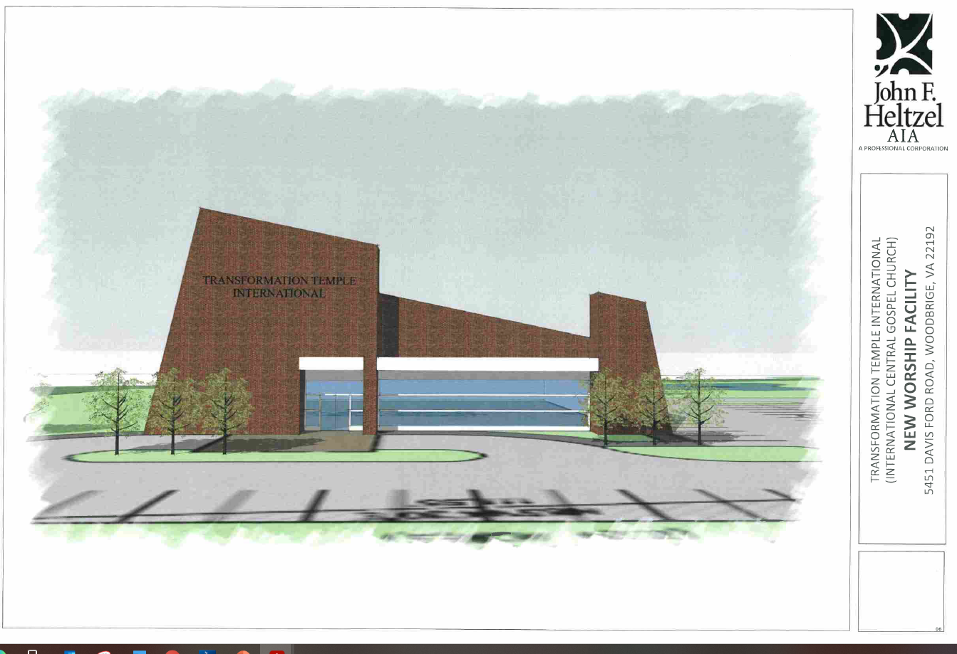

Slide 12
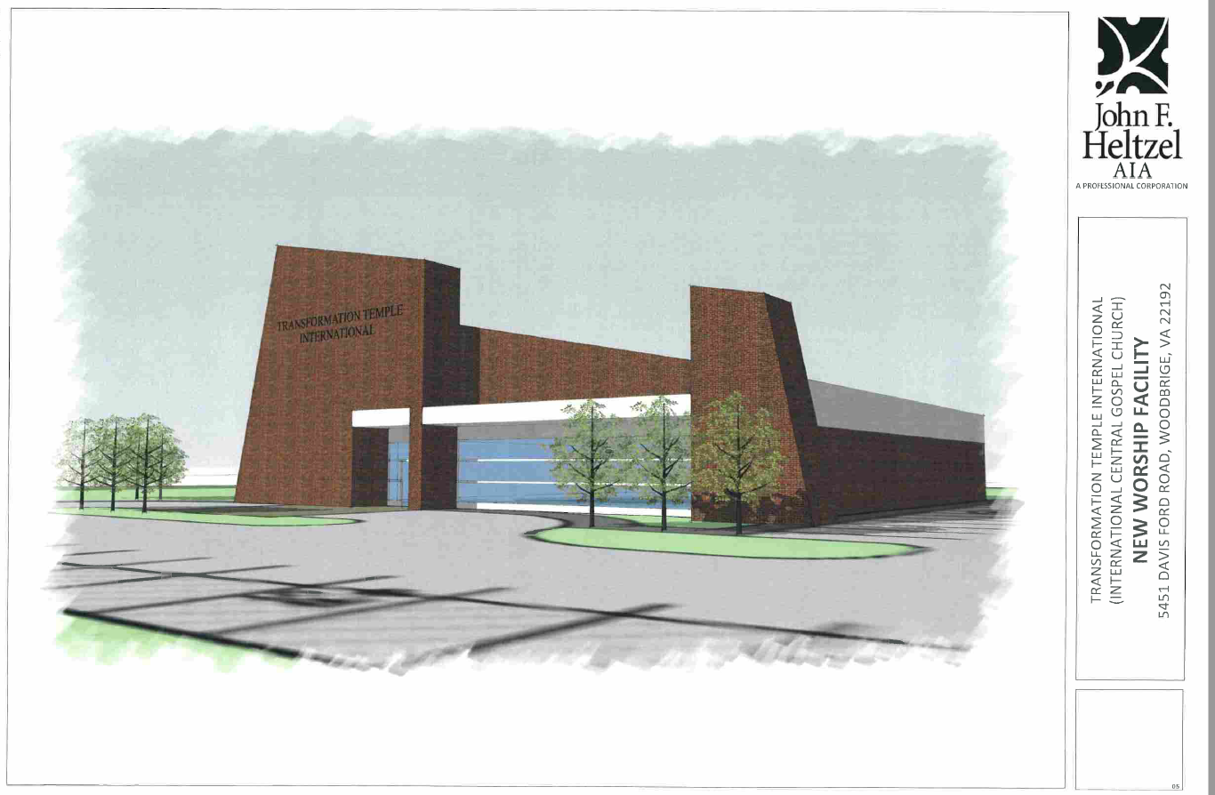

Slide 13
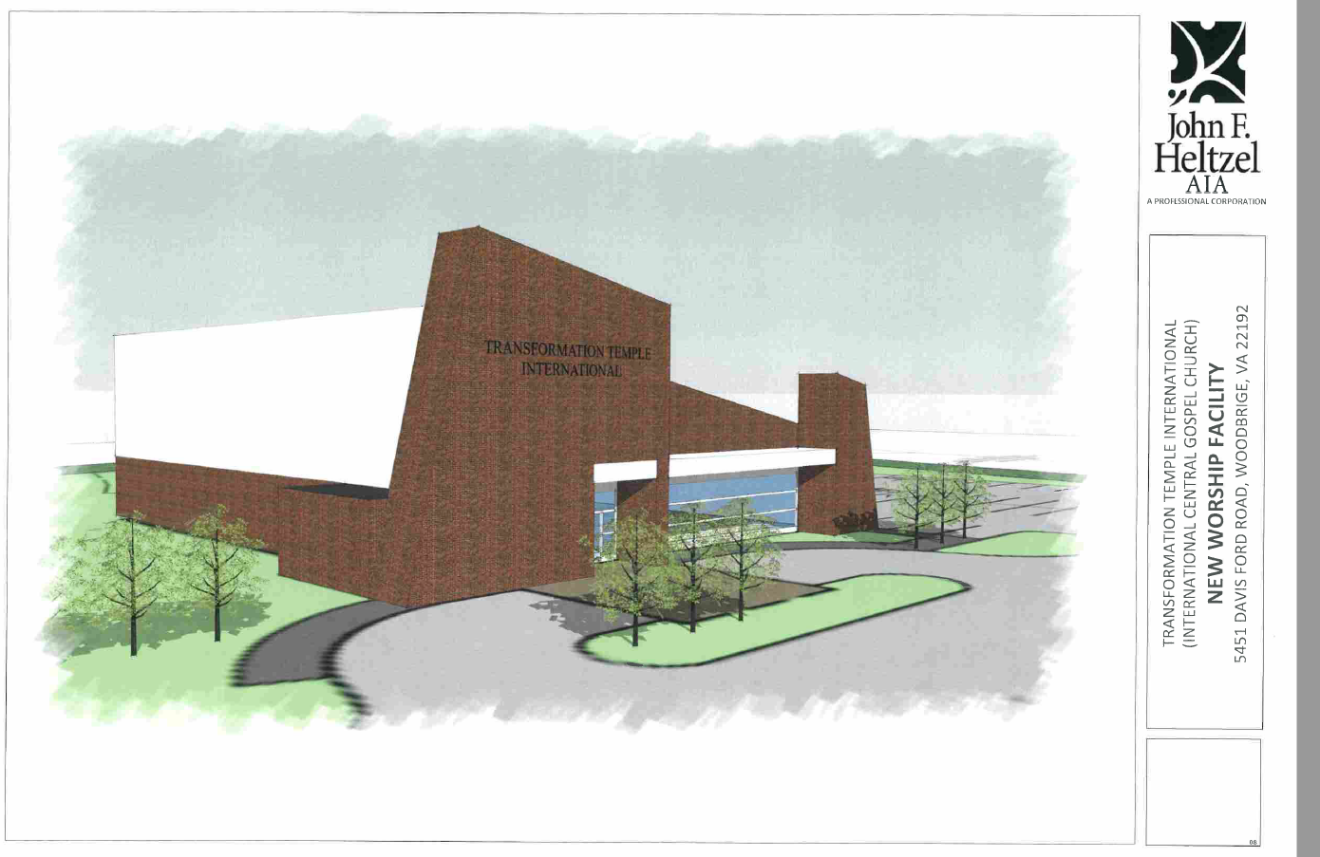

Slide 14
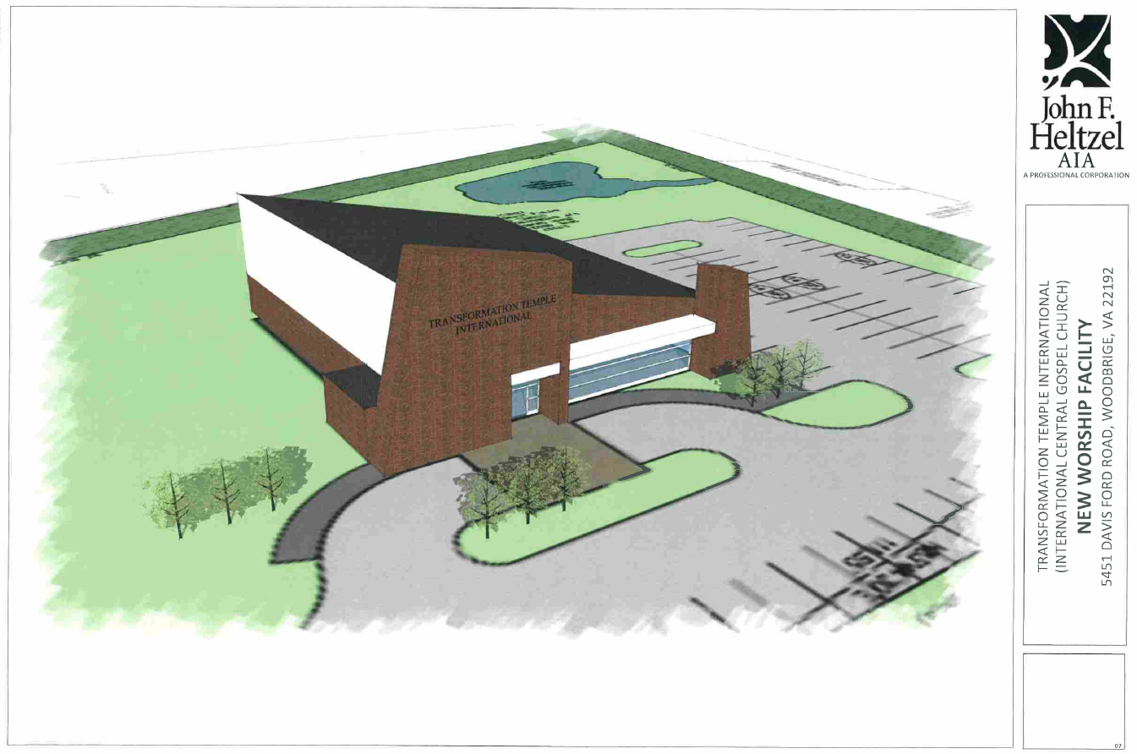

Slide 15
