Slide 1
MID COUNTY CIVIC ASSOCIATION OF PRINCE WILLIAM PRESENTATION BY PRIMELAND, LLC
Proffer Condition Amendment to REZ #1989-0074 (RZPA 2020-00037)
GPIN #8192-76-5856
DECEMBER 17, 2020

Slide 2
Project Team
Fundi Choudry, Owner representative
Giff Hampshire, Blankingship & Keith, legal
John Wright, Bohler, Engineering
DBI, Architects
WSSI, Environmental

Slide 3
Application in a Nutshell
Proffer Condition Amendment for 2.53 portion of 24.5- acre 1990 office park rezoning never constructed
Eliminate office use requirement to allow retail with potential residential as second phase or together
Allow potential residential units on second and third floor of retail as allowed by ZO § 32-400.25
Modify 1990 GDP with by new GDP consistent with the above and with new Dale City Sector Plan and ZO
Result is Development Consistent with Dale City Sector Plan and Zoning Ordinance.

Slide 4
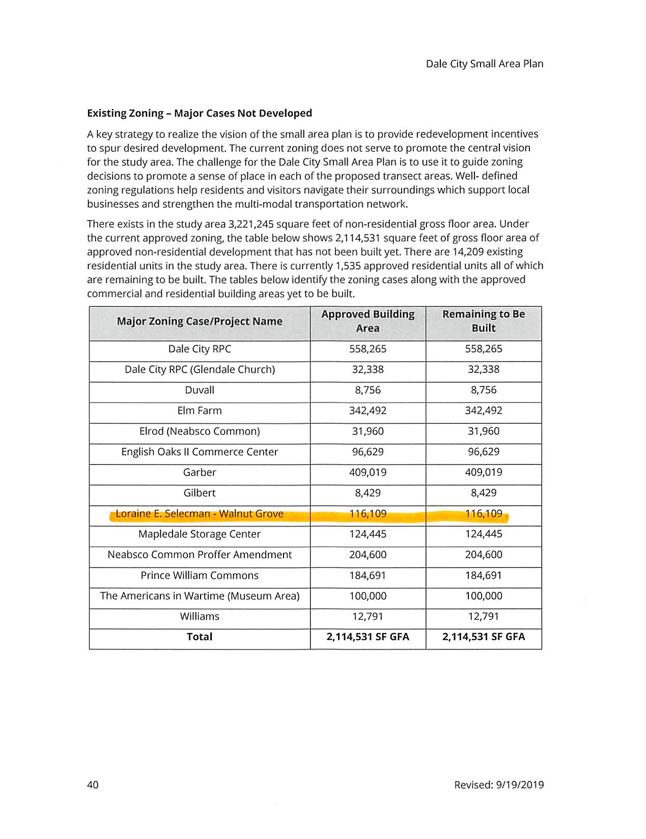

Slide 5
Procedural Posture
Preapplication Meetings with Staff 11/21/19 and 03/19/20
Meeting with Supervisor Angry’s Office 04/2/20
Application Submitted 7/9/20
Comments Received 9/03/20
Post Submission Meeting 9/15/20
Second Submission 11/23/20

Slide 6
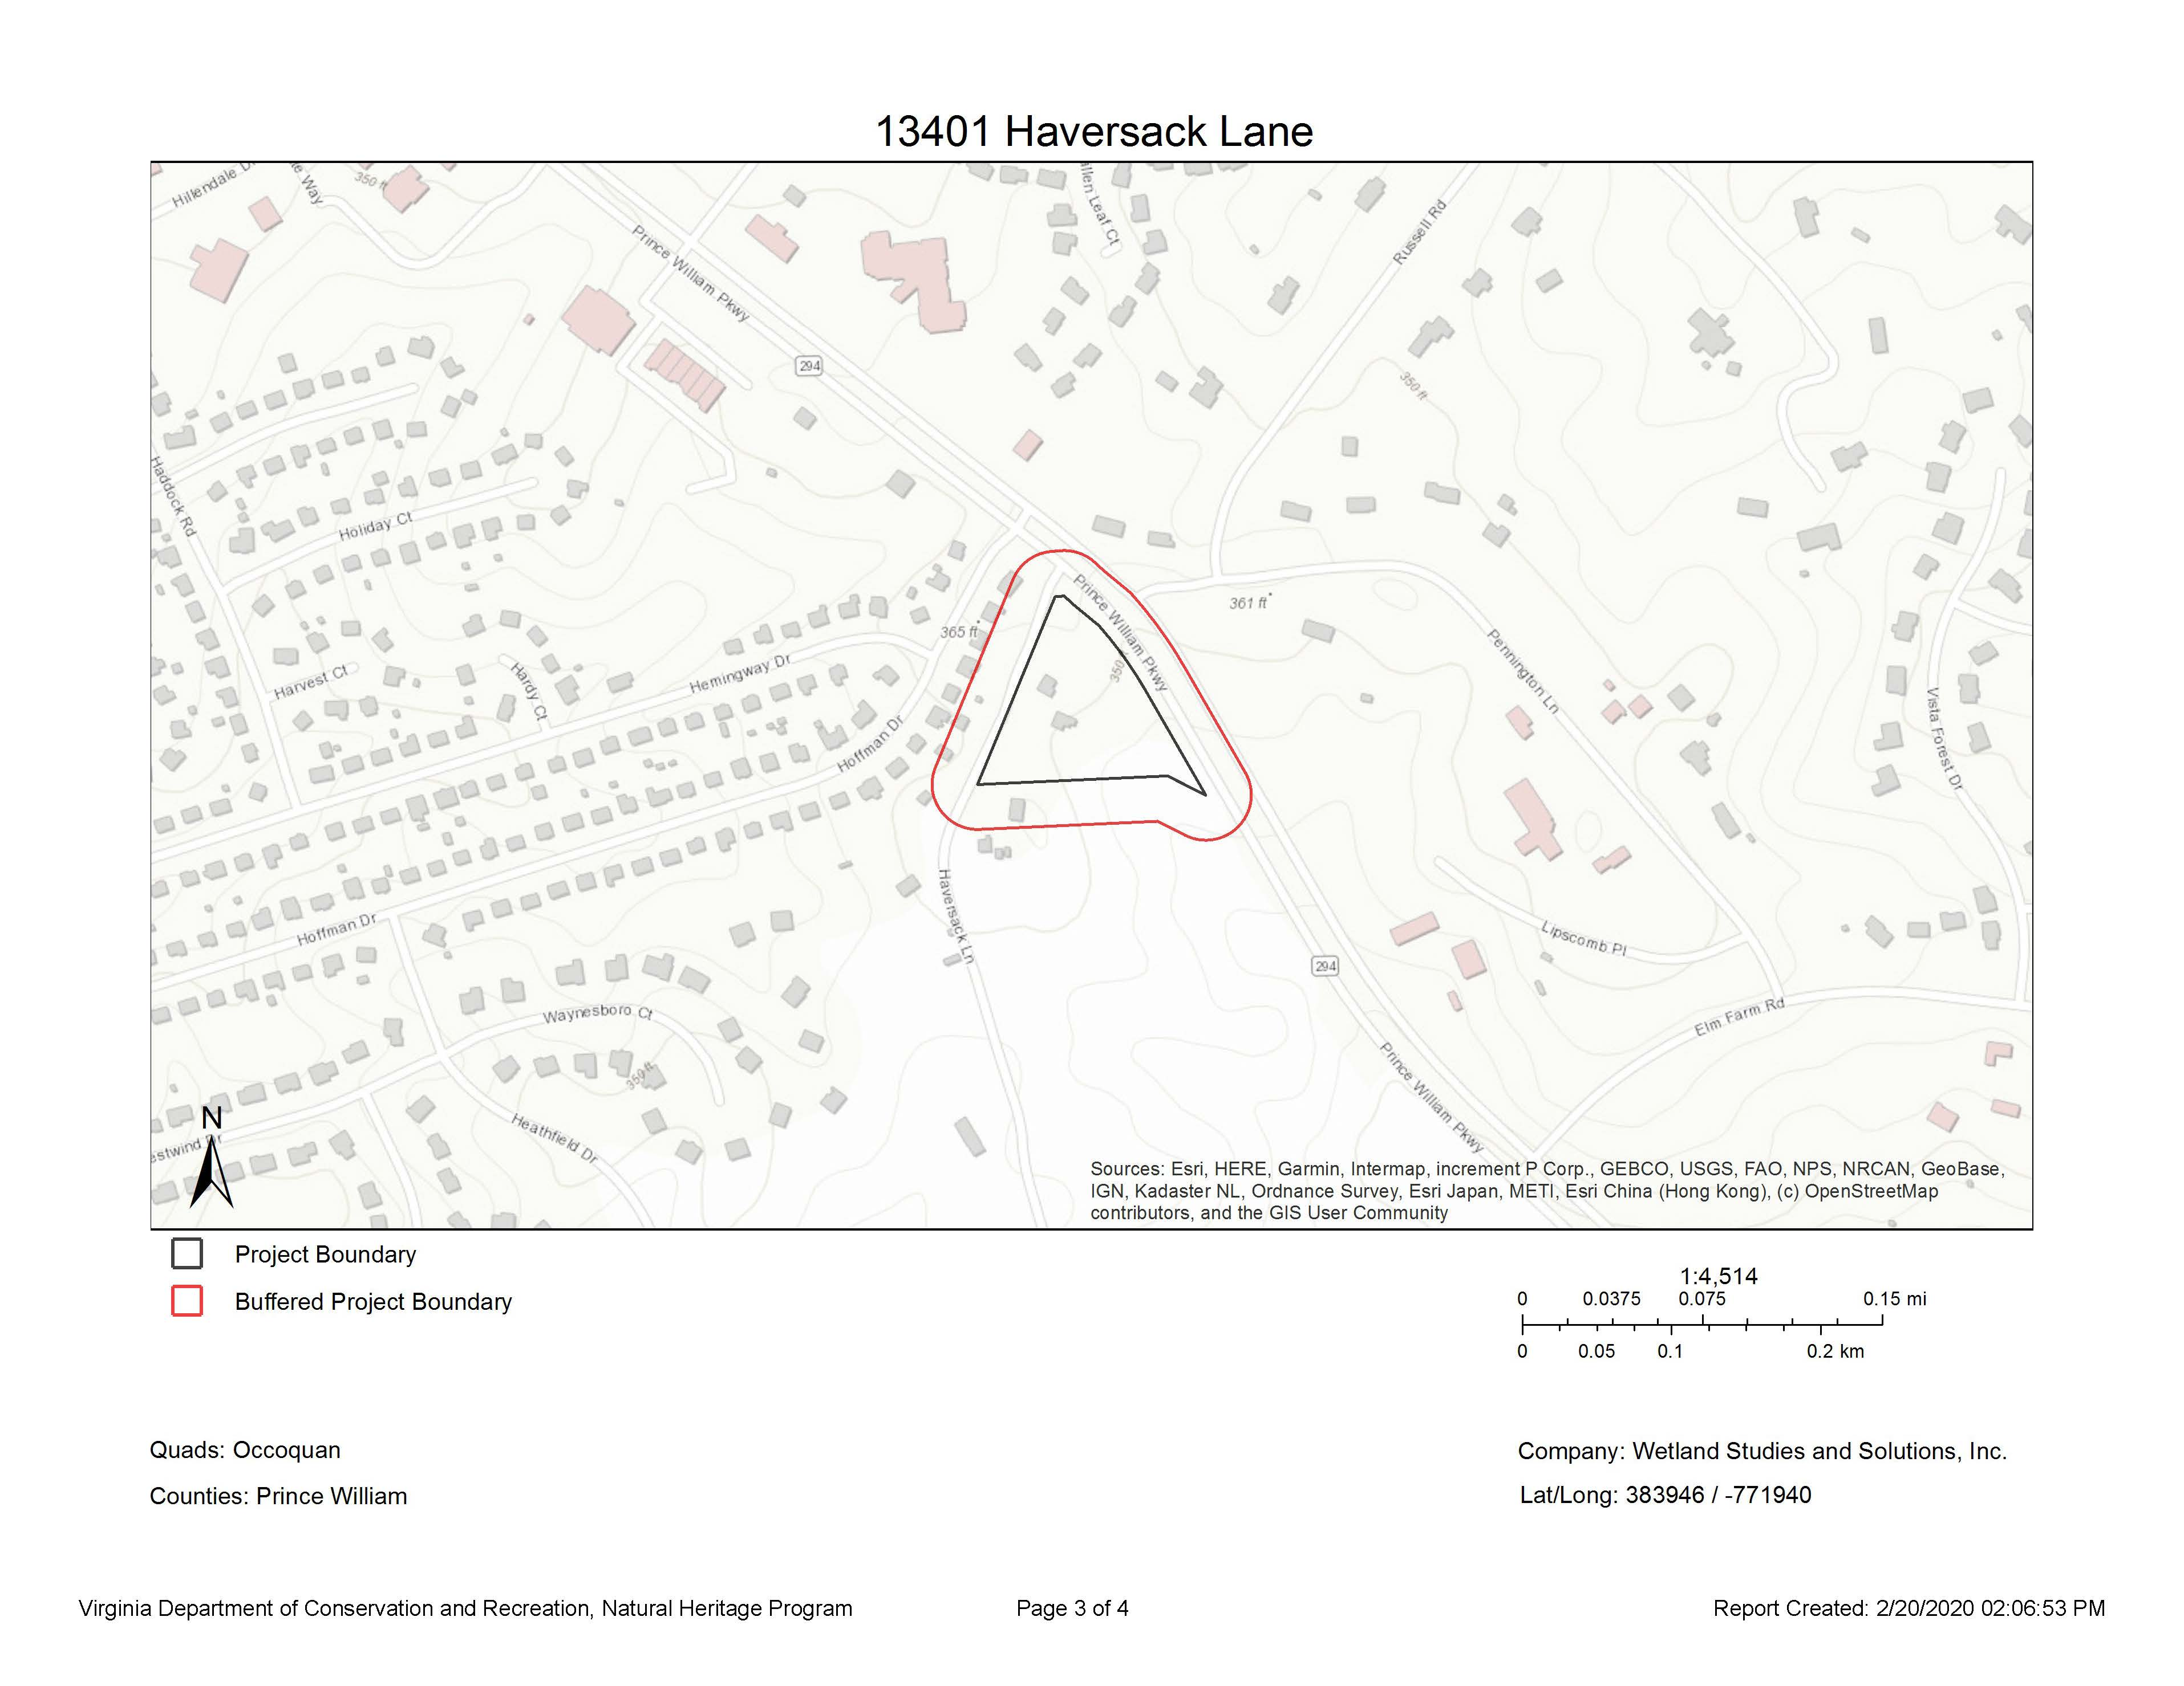

Slide 7
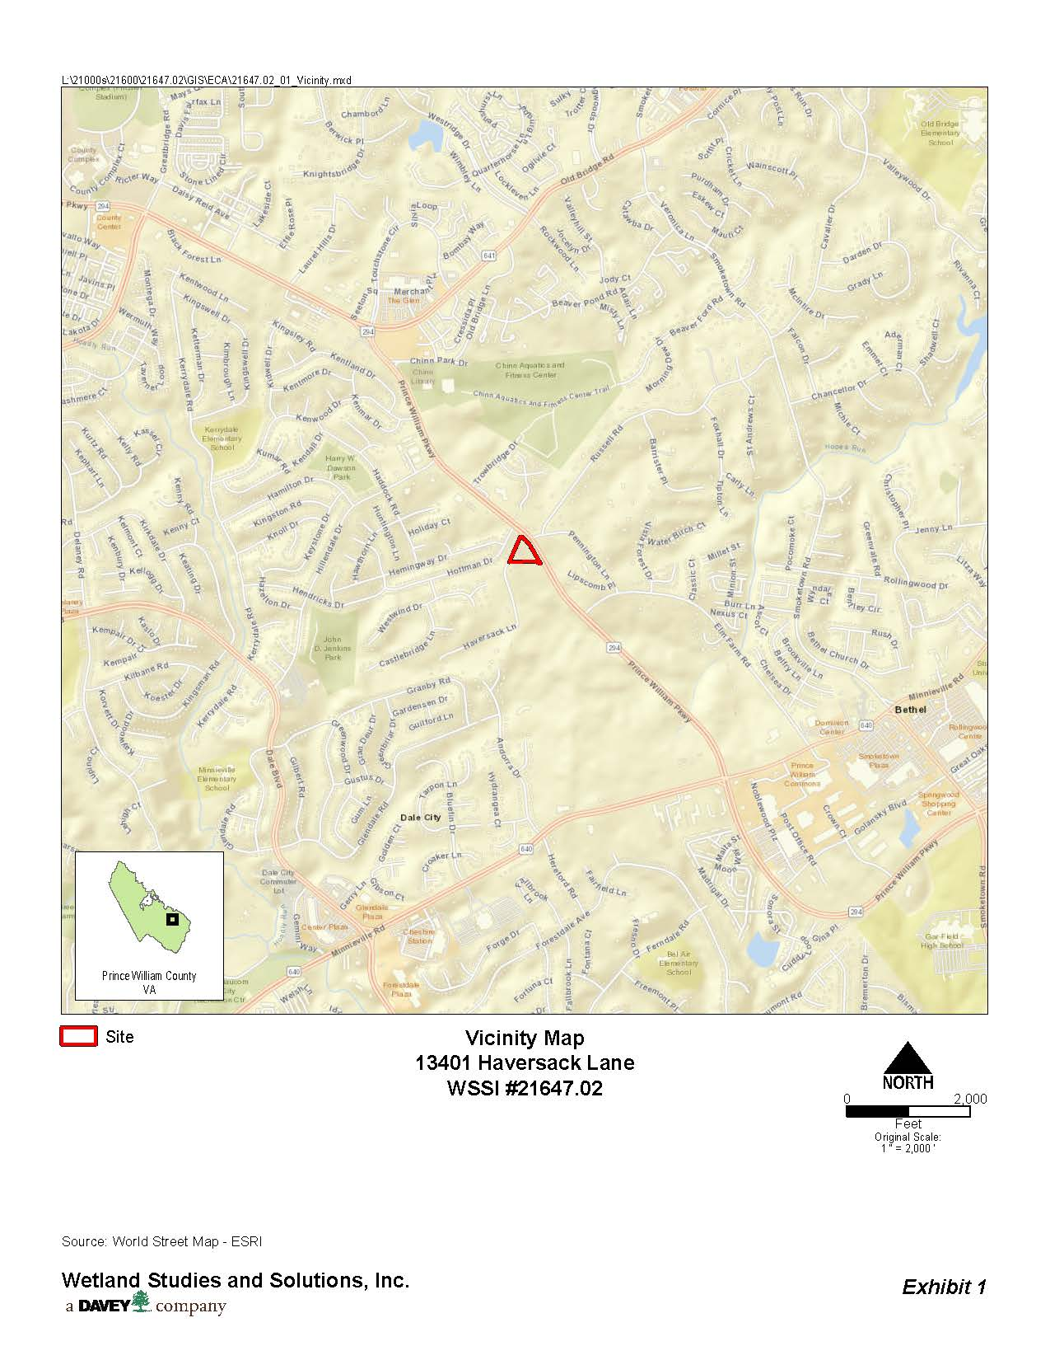

Slide 8
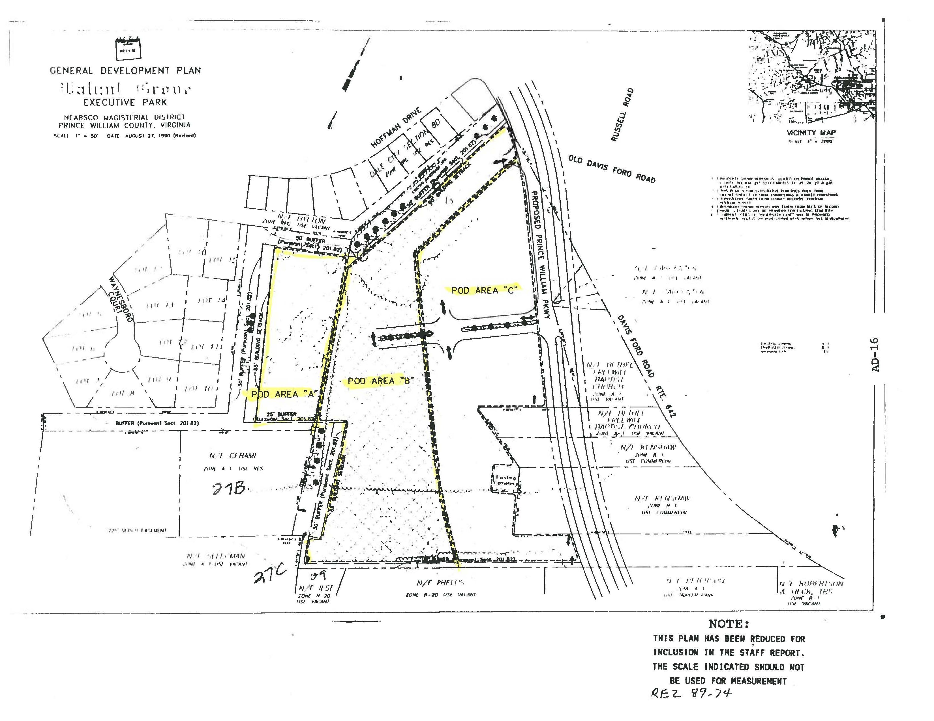

Slide 9
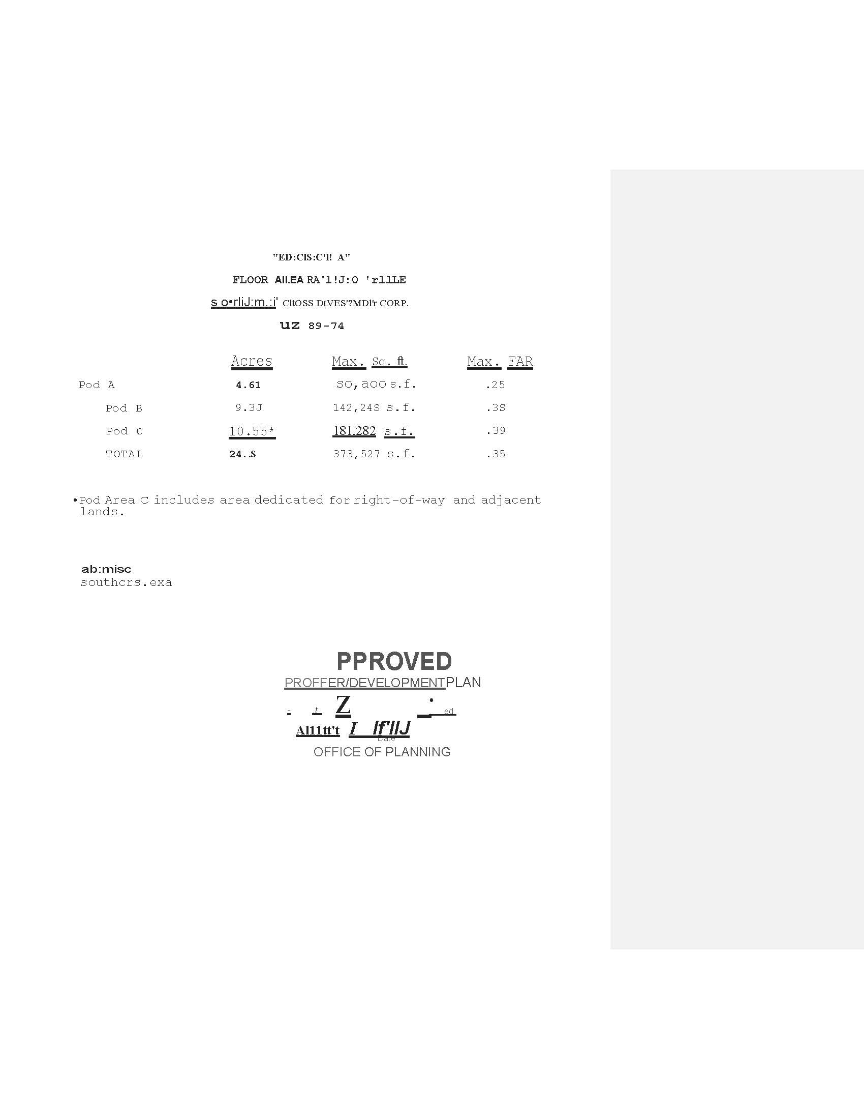

Slide 10
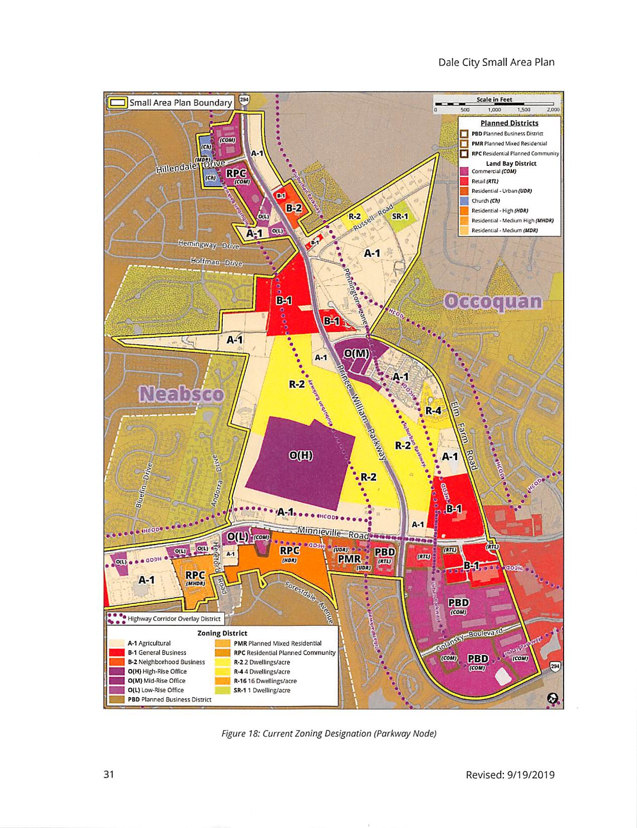

Slide 11
PROPOSED NEW DEVELOPMENT IN 1990 PODS B & C
.31 FAR
Allow Retail Uses in Pod Area B
Remove Requirement that buildings in Pod Area C contain minimum 40% Office
Allow potential for residential Units on 2nd and 3rd Floor of Retail (ZO § 32-400.25)
Residential Density 16 Units or 6.32/Acre consistent with 1-10 Sector Plan Density.
Result would be replacement of antiquated office park development with retail or mixed-use development consistent with Dale City Sector Plan.

Slide 12
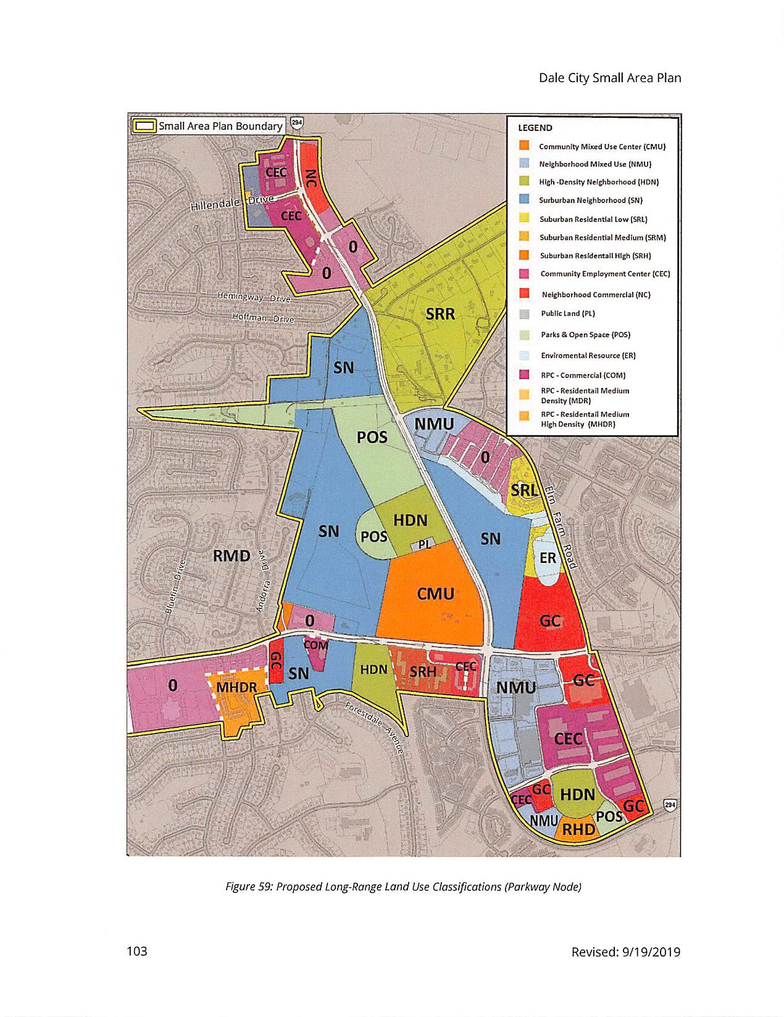

Slide 13
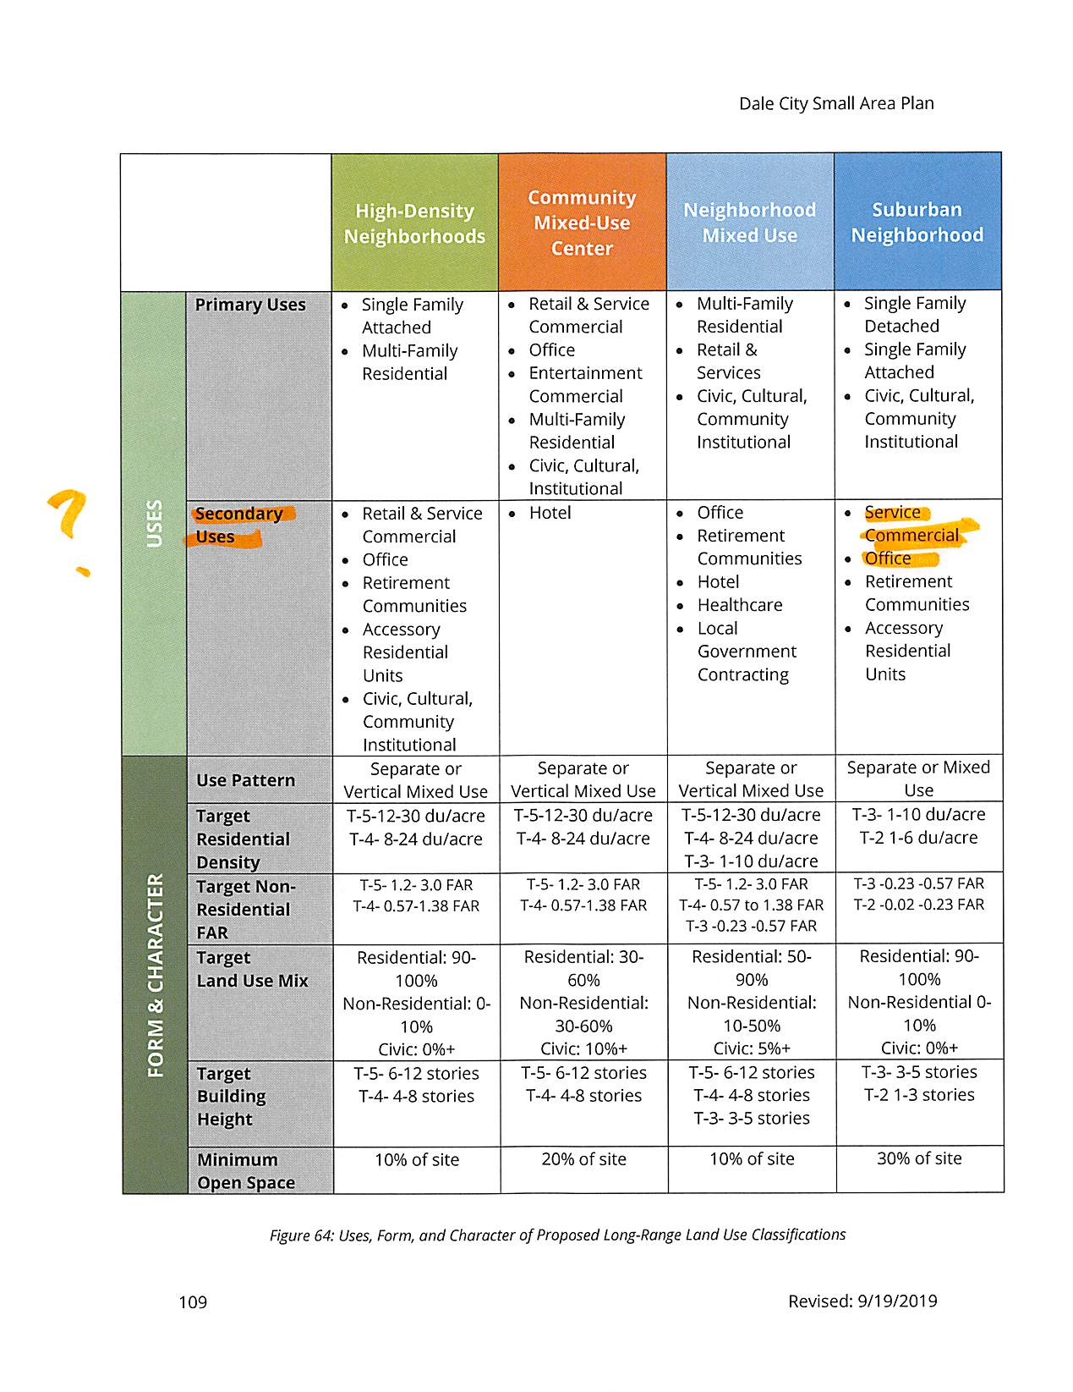

Slide 14
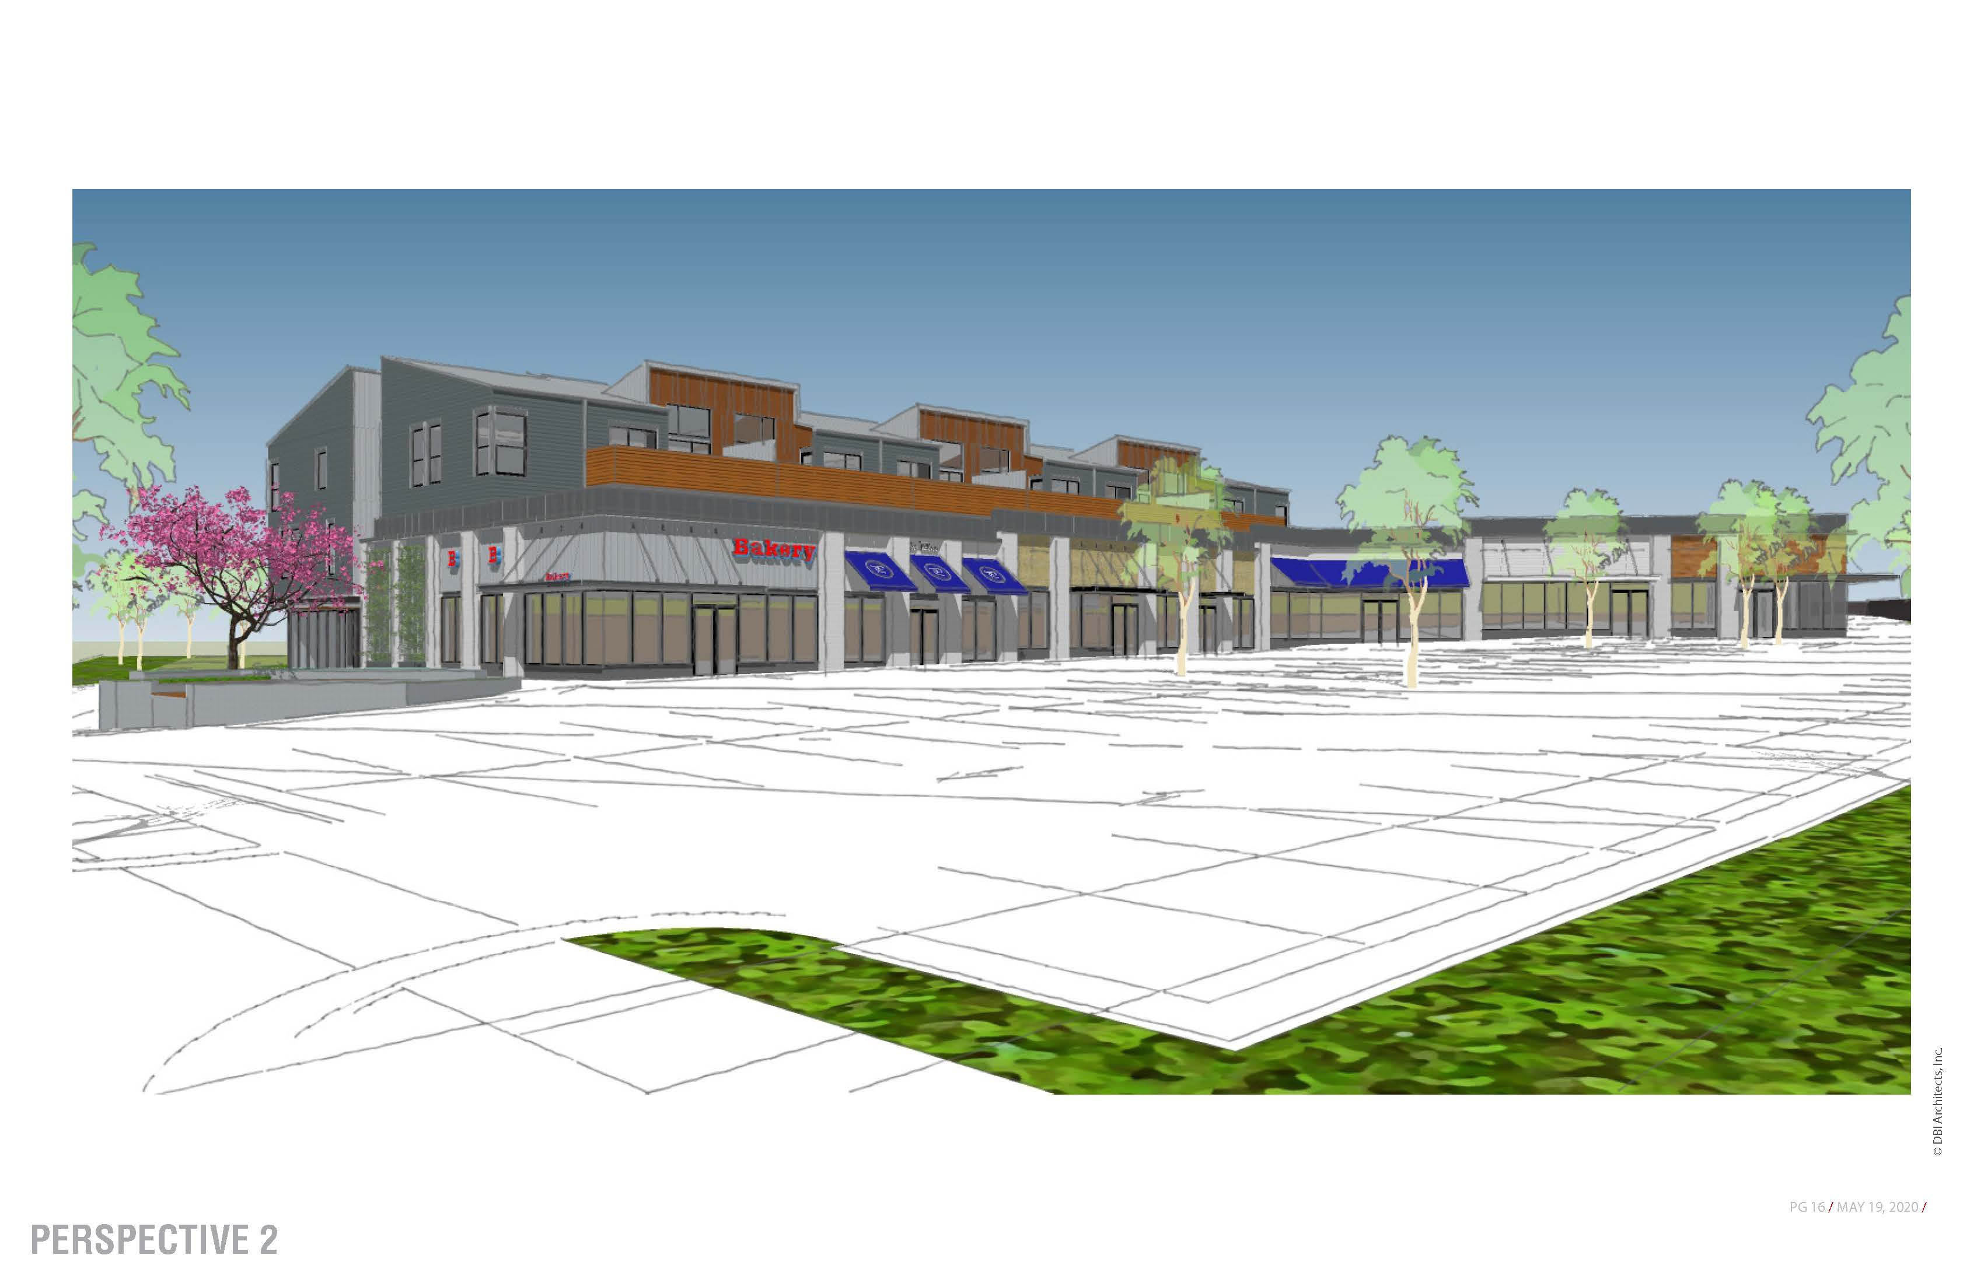

Slide 15
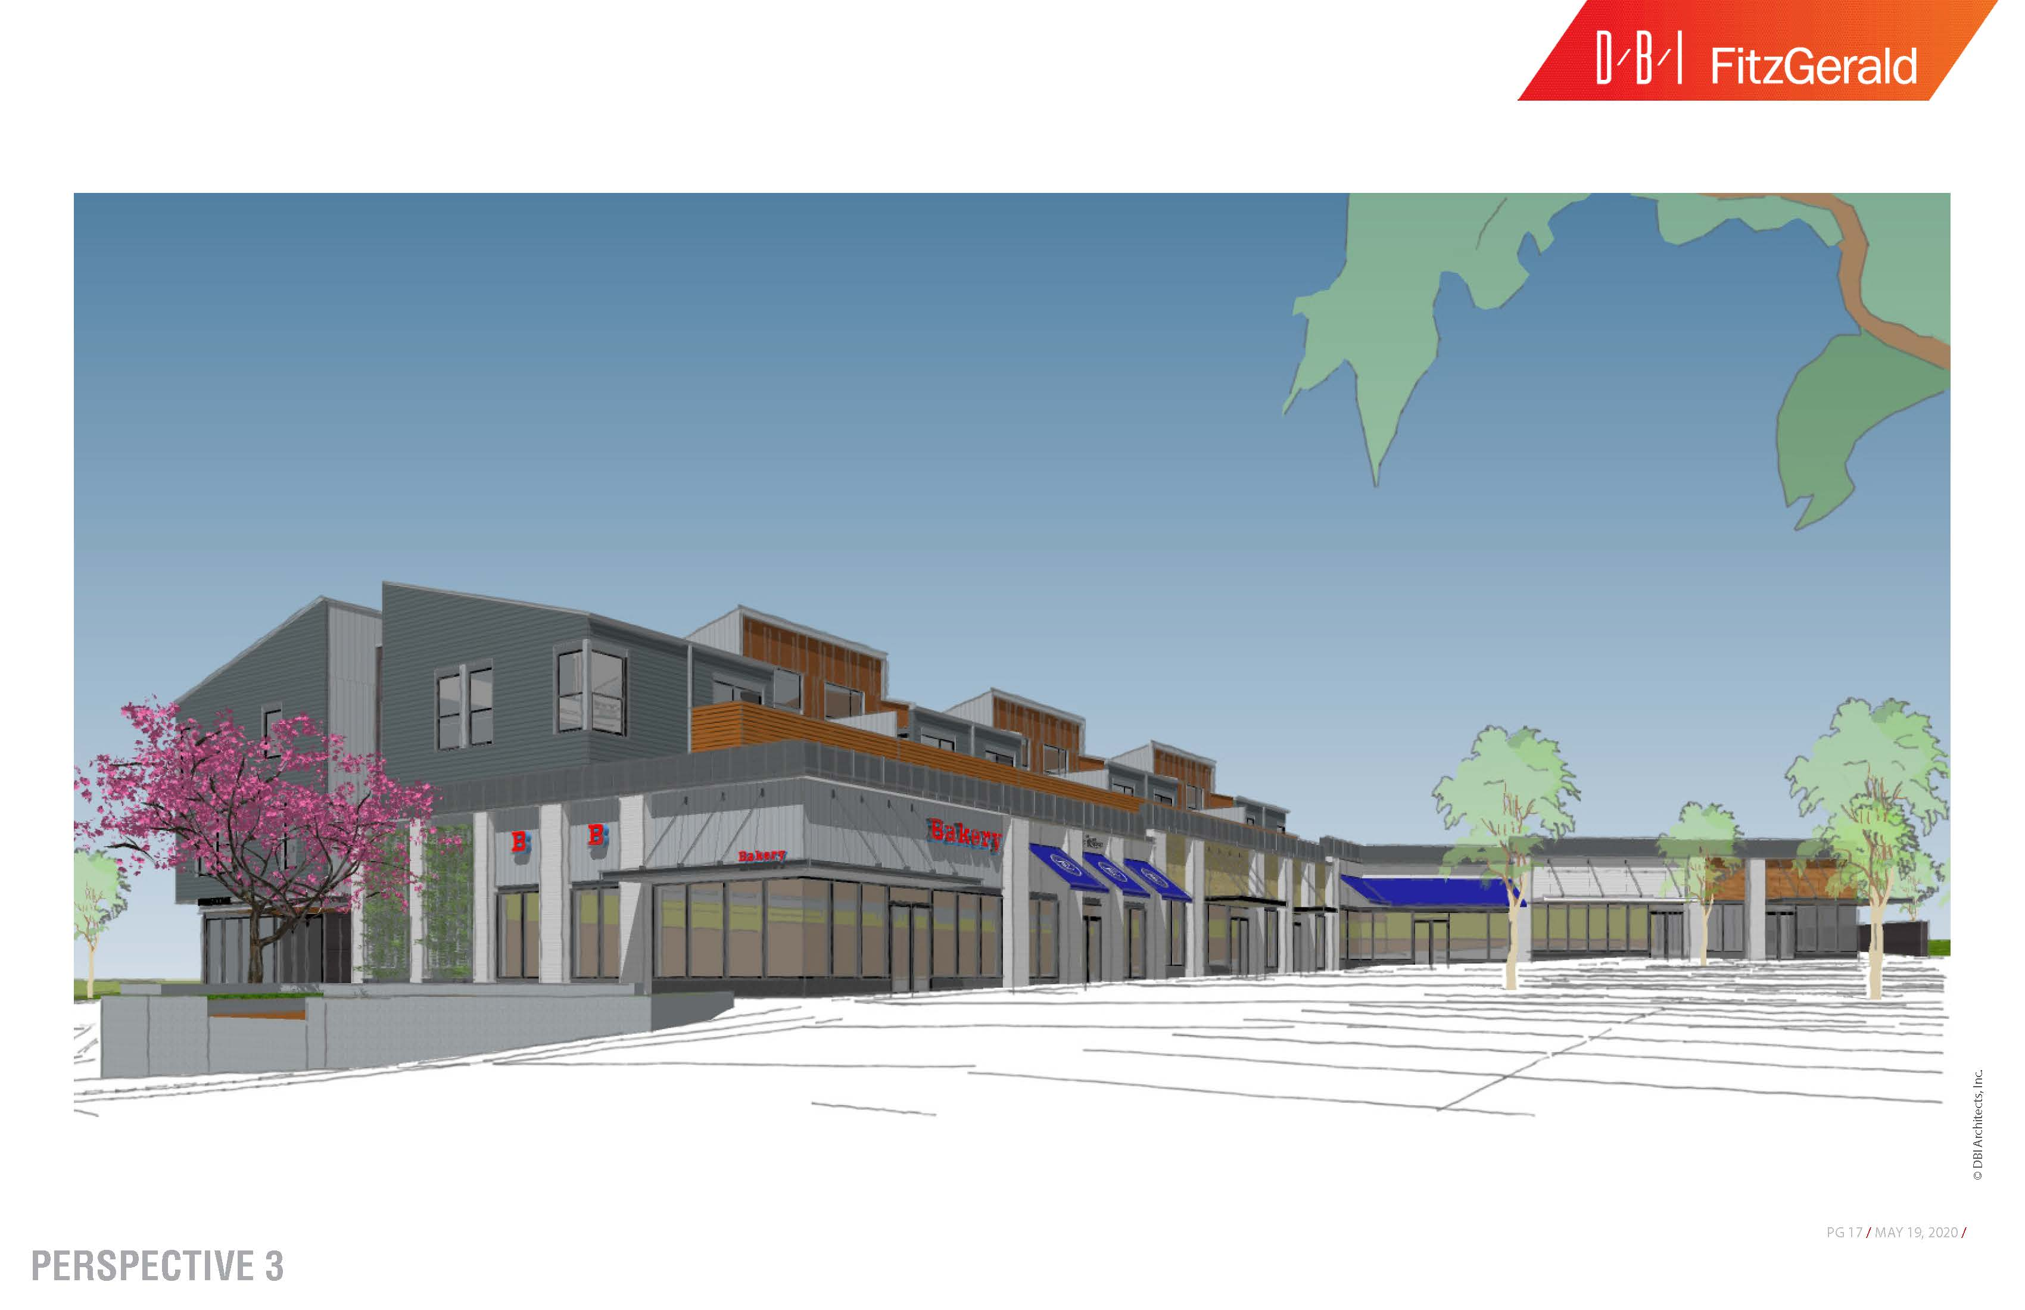

Slide 16
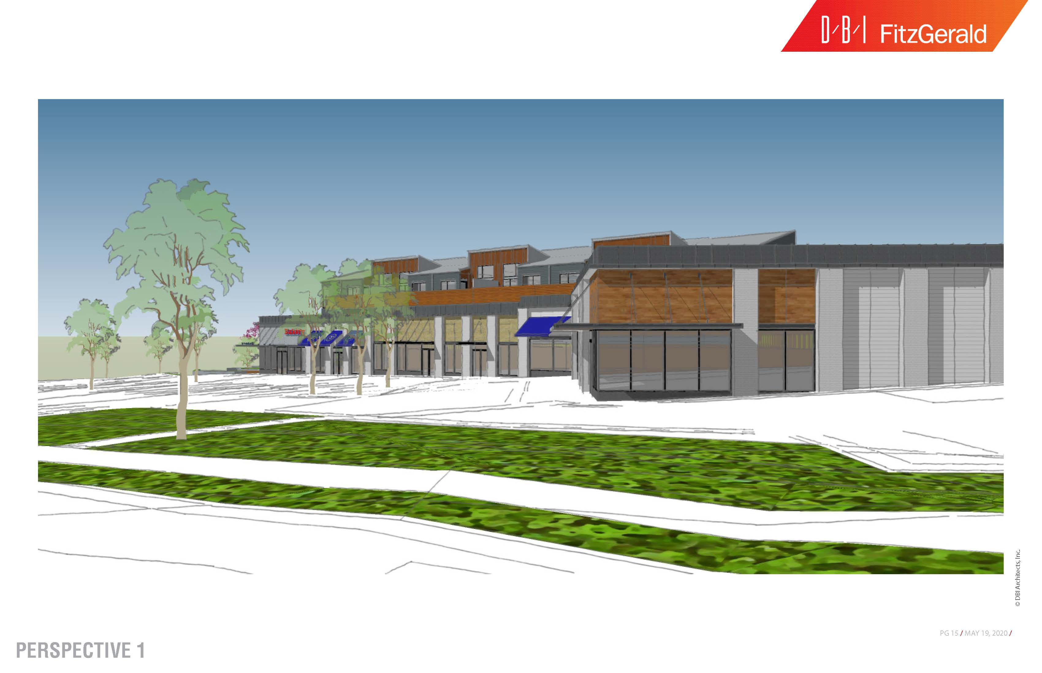

Slide 17
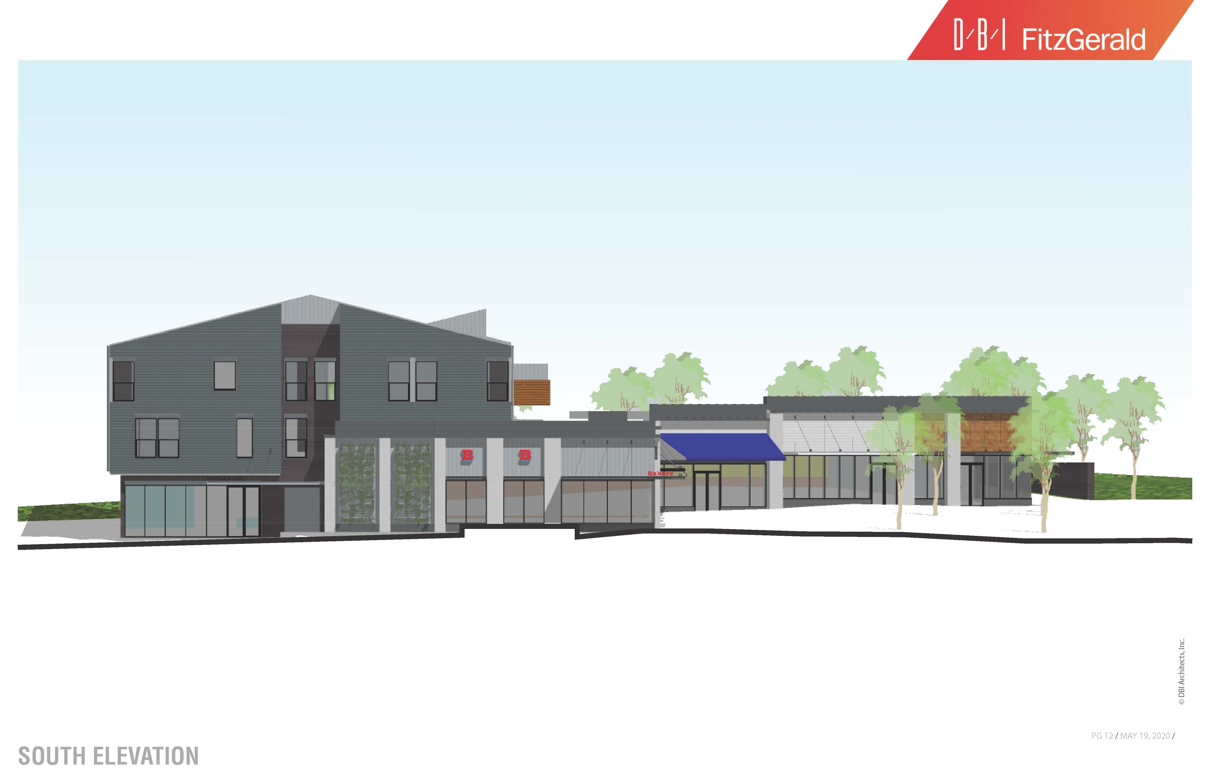

Slide 18
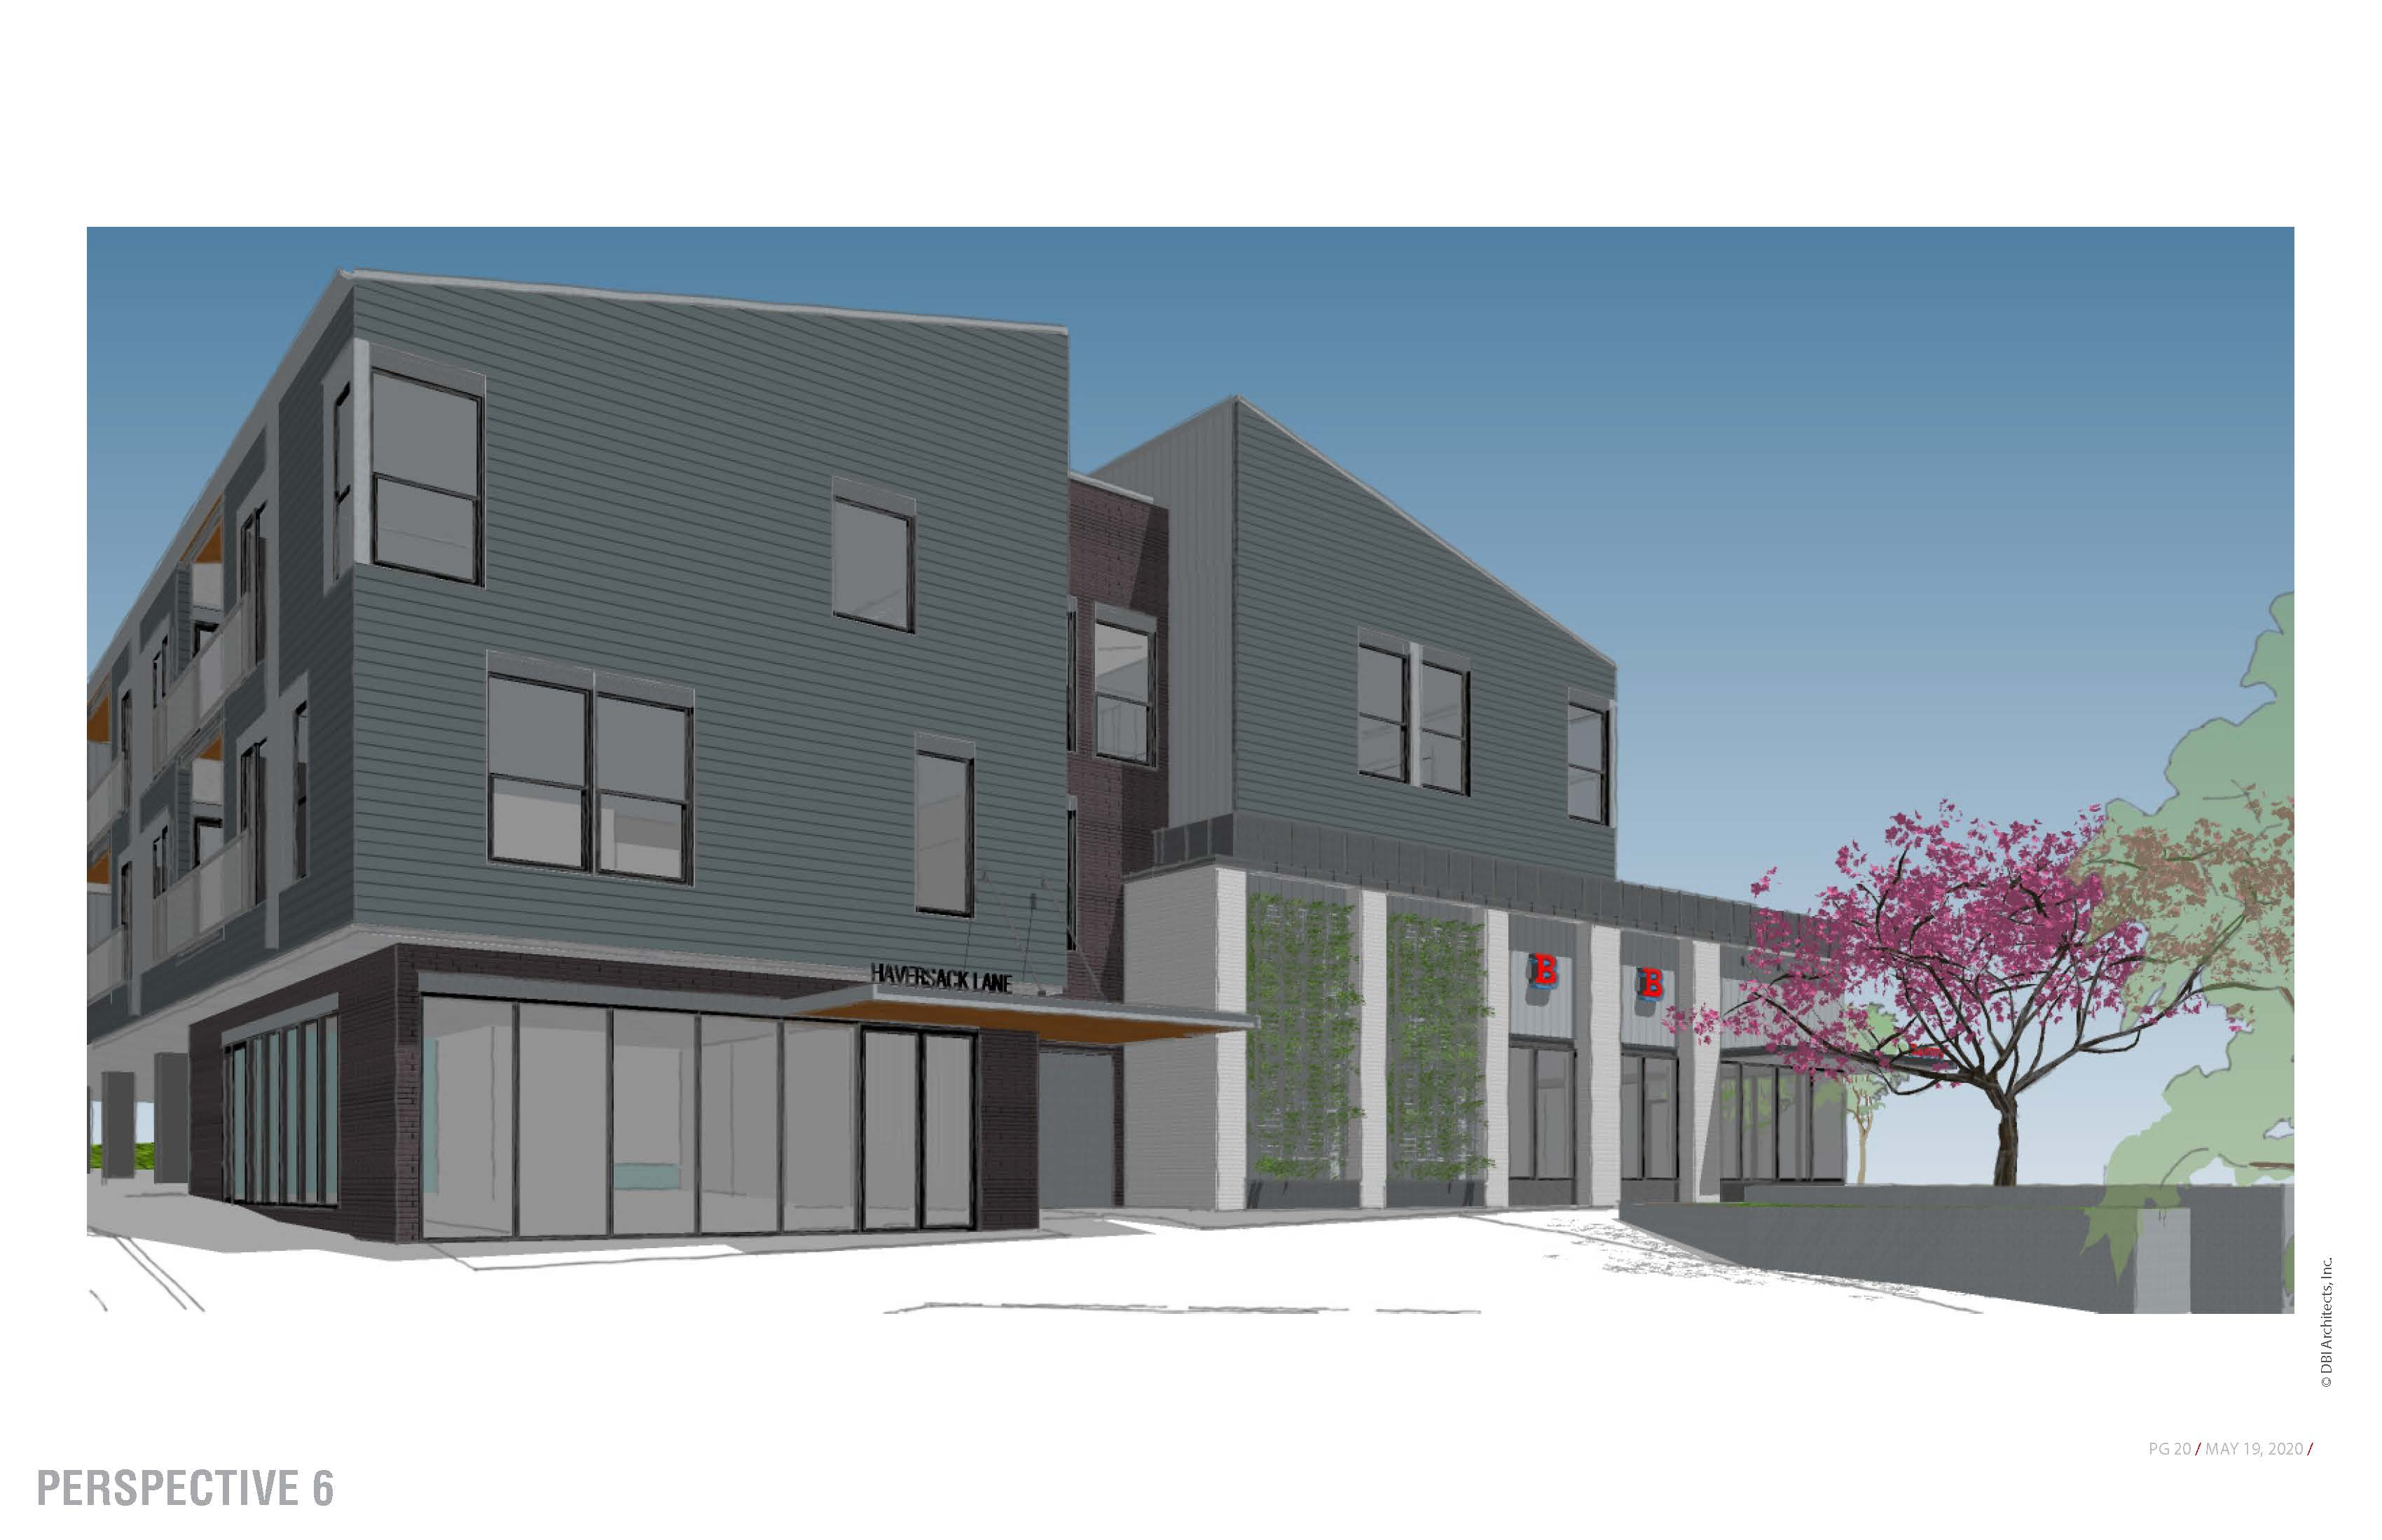

Slide 19
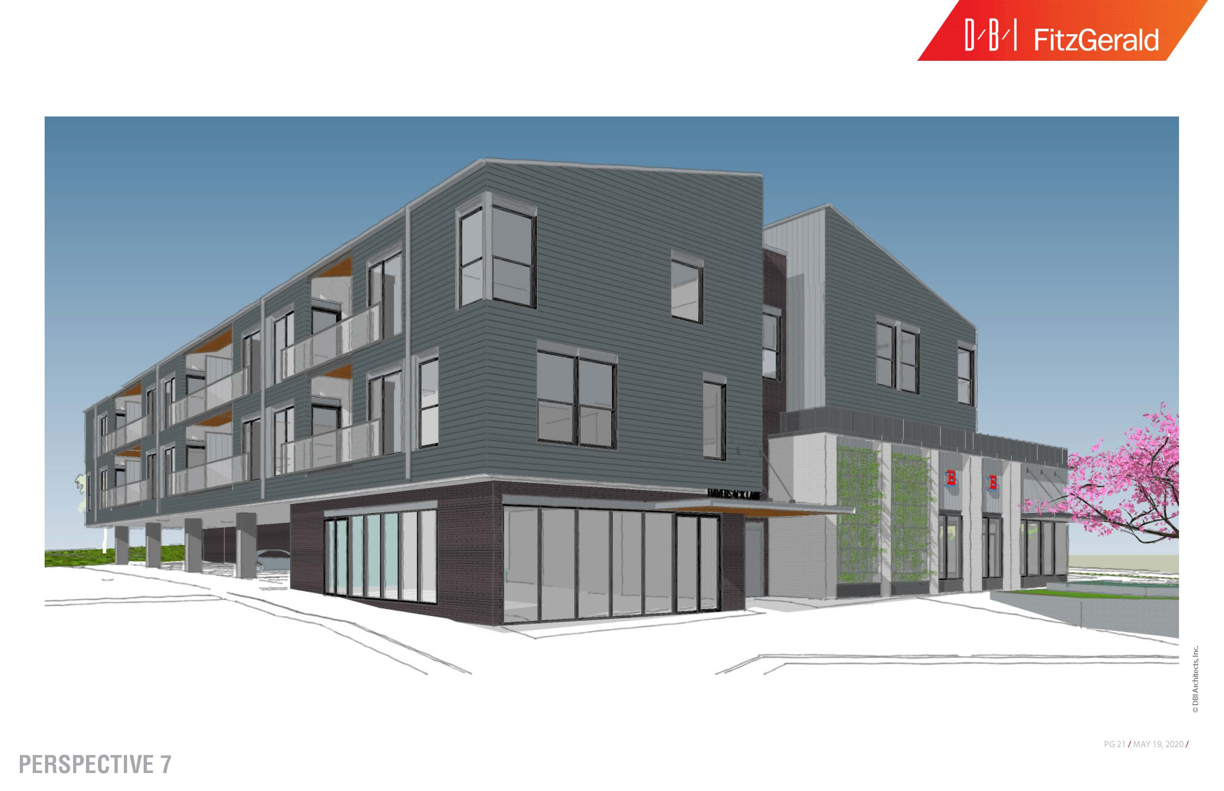

Slide 21
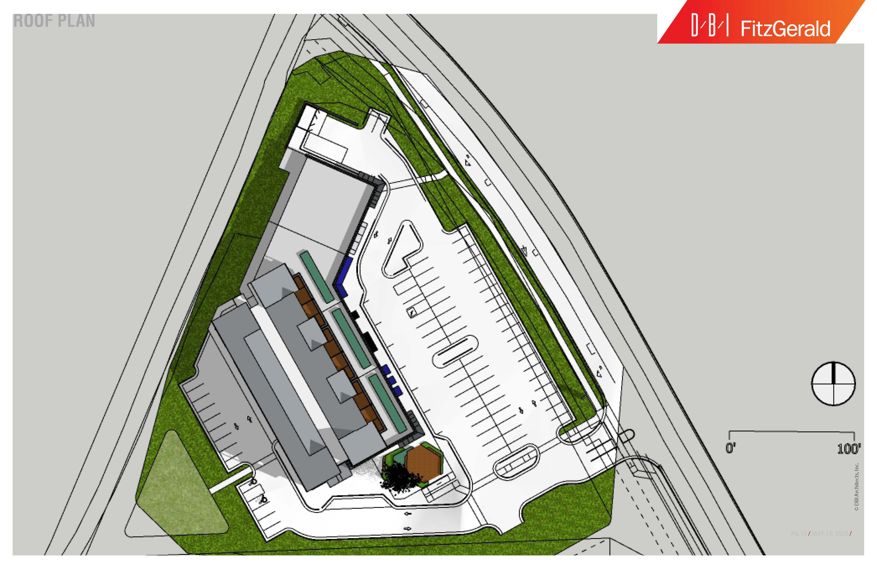

Slide 22
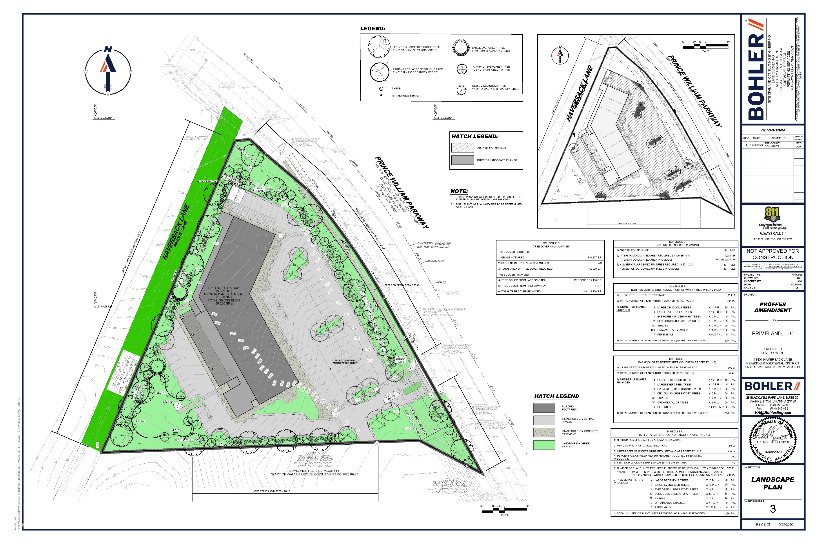

Slide 23
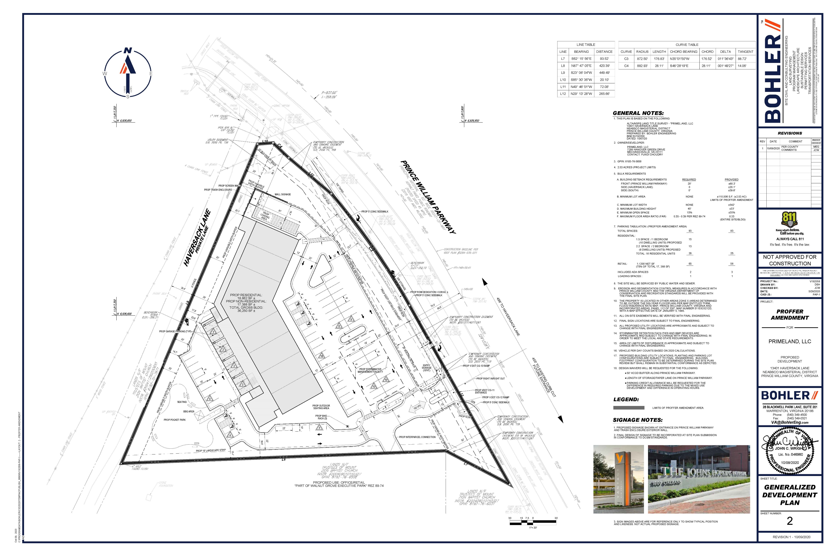

Slide 24
