Slide 1
Mohammadia Mosque

Slide 2
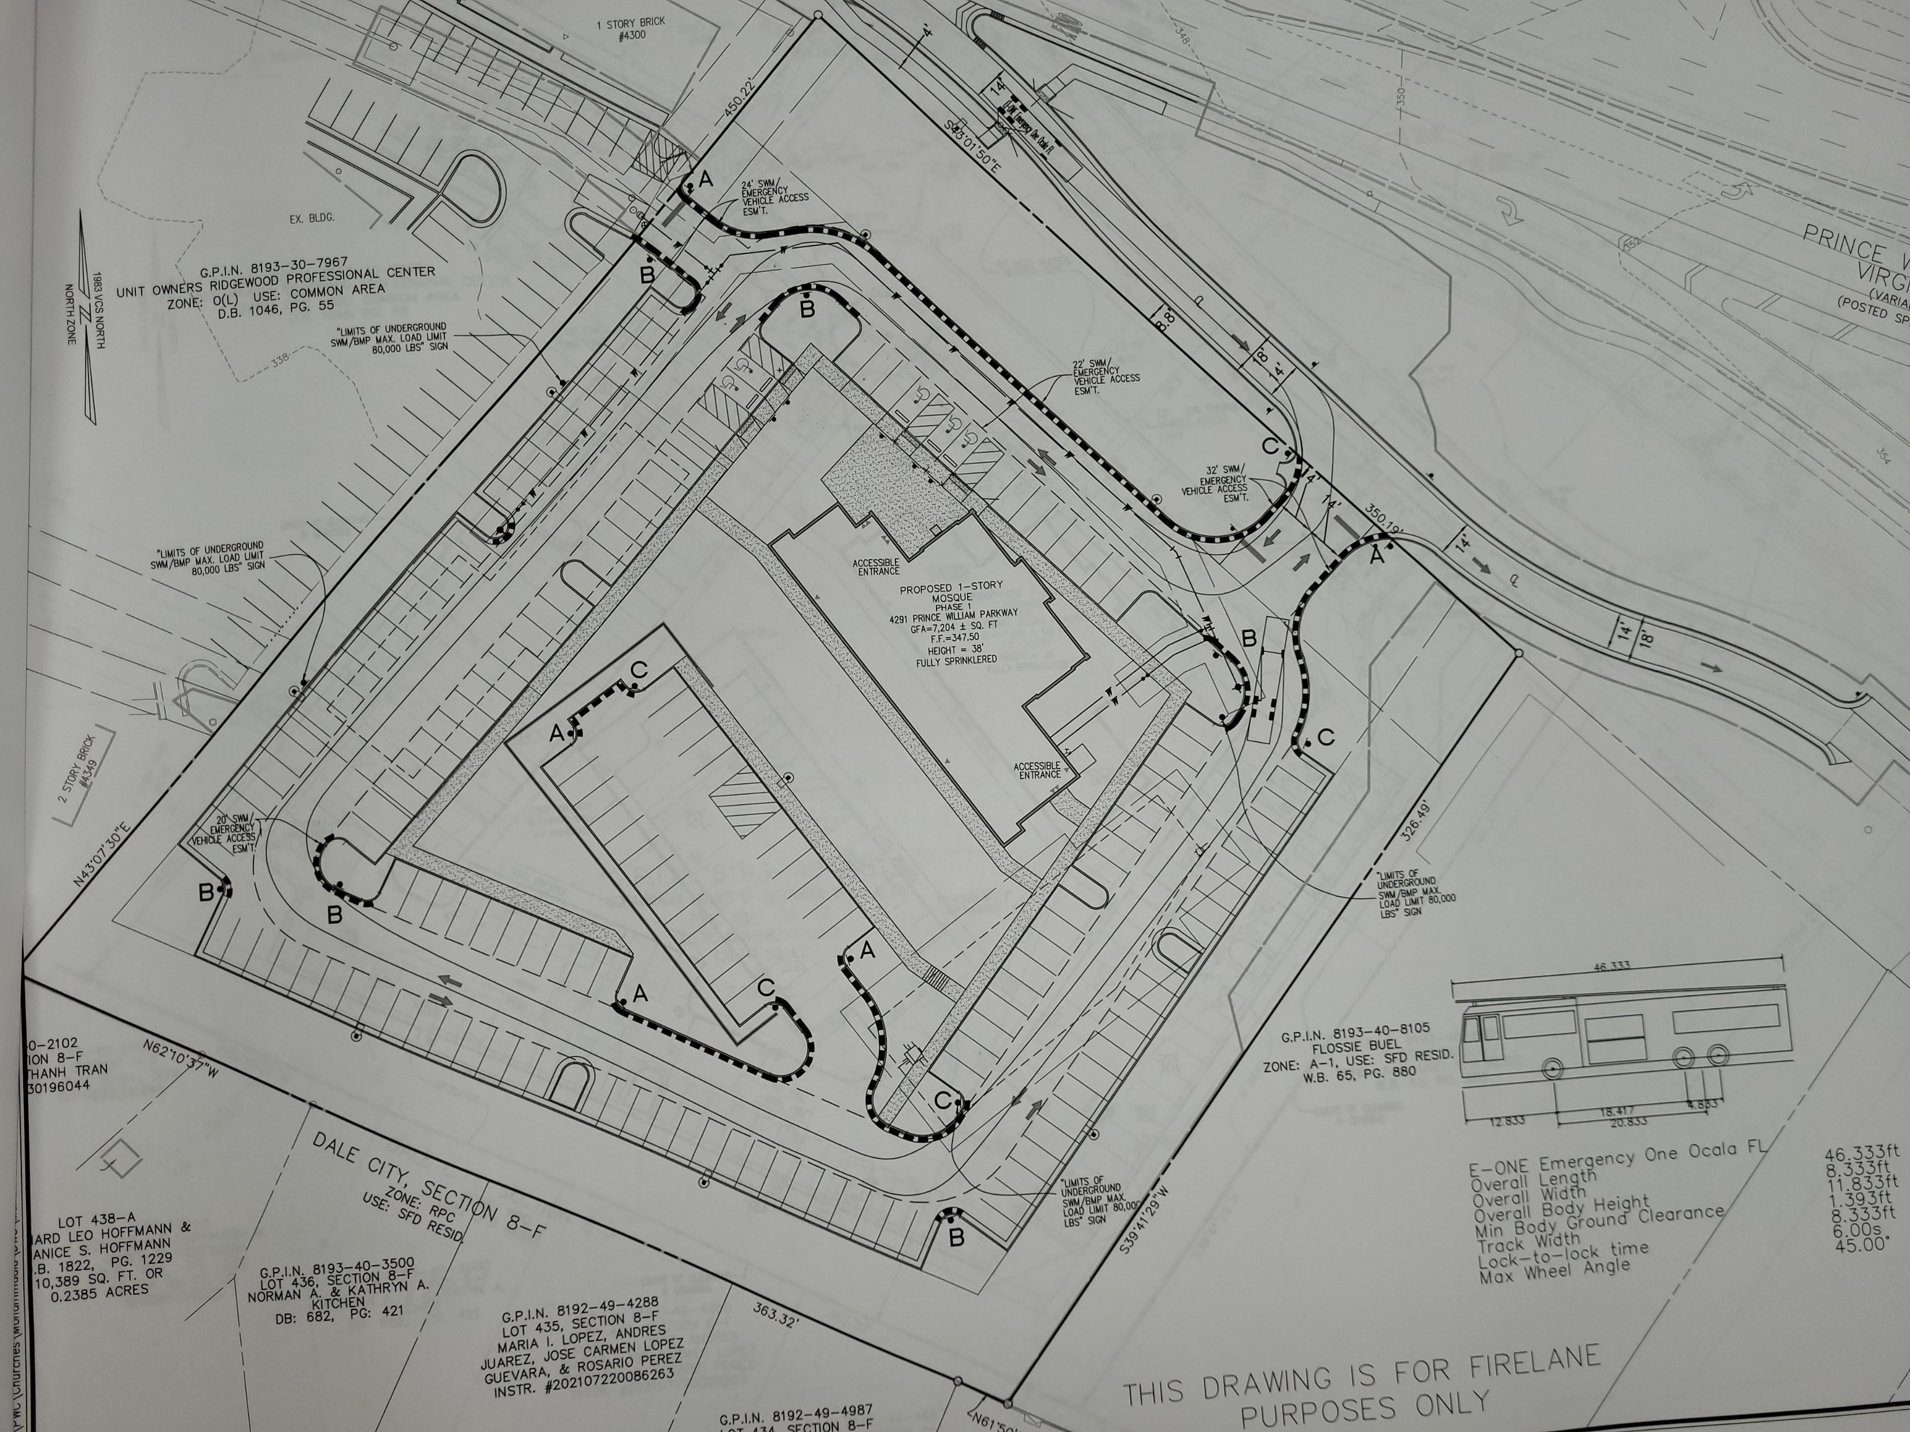
Building:
7204 Sq. Ft.
347 Prayer rugs
38 feet tall

Slide 3
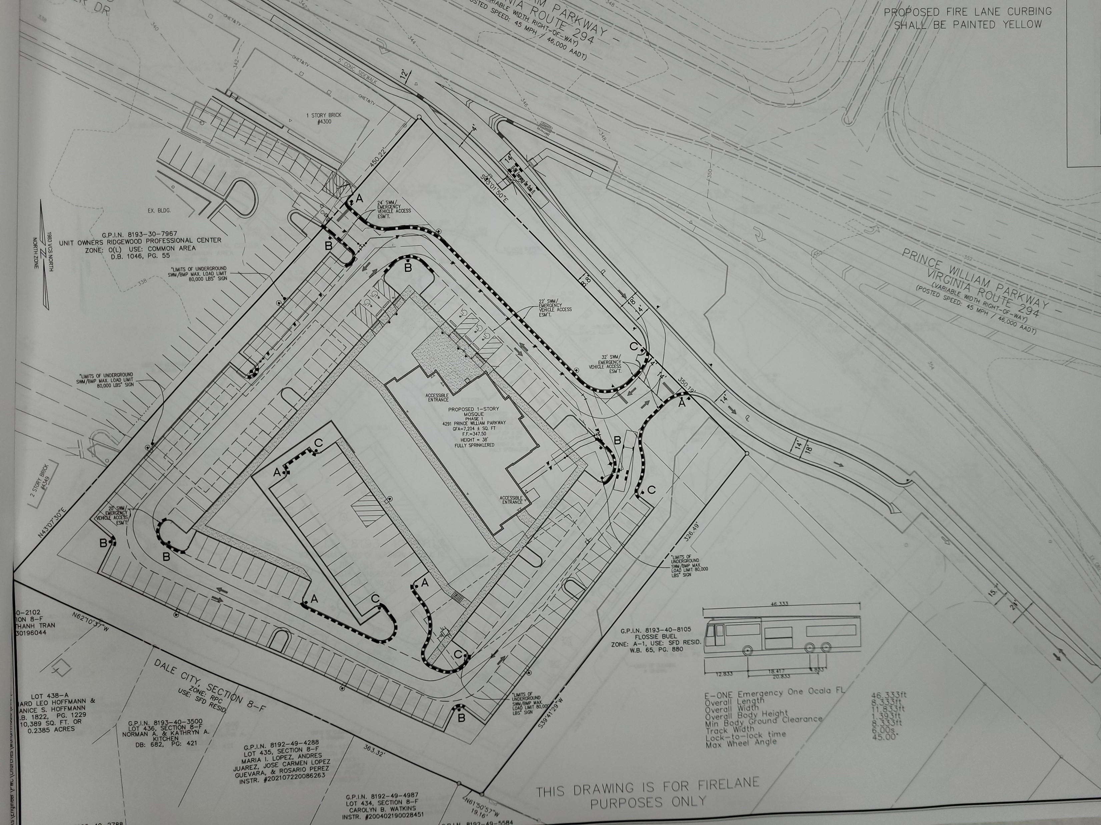
Entrance design:
Conflicts with the proposed VDOT design

Slide 4
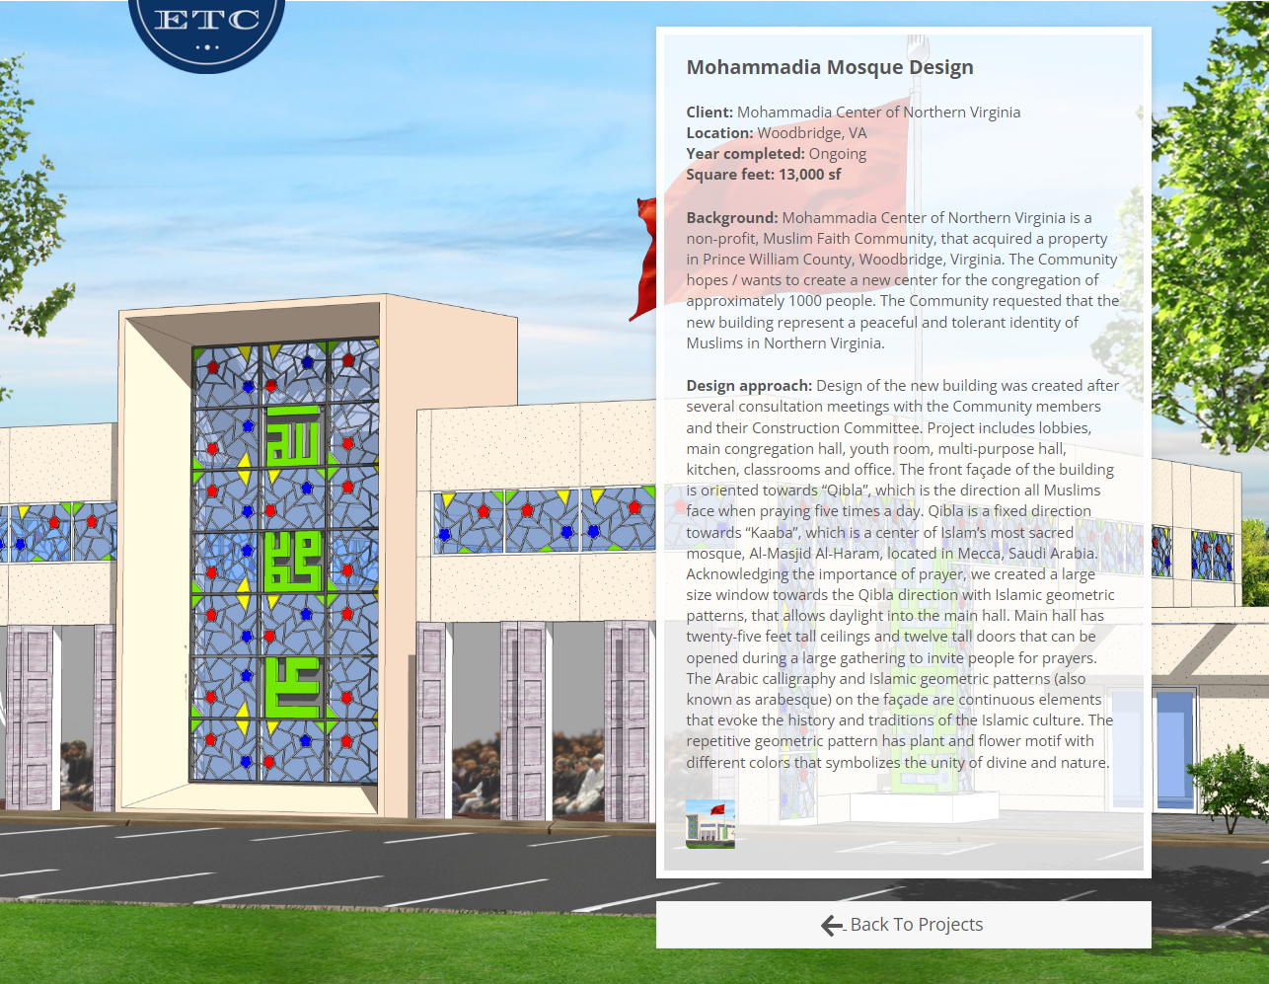
13,000 Sq. Ft.
1000 prayer rugs

Slide 5
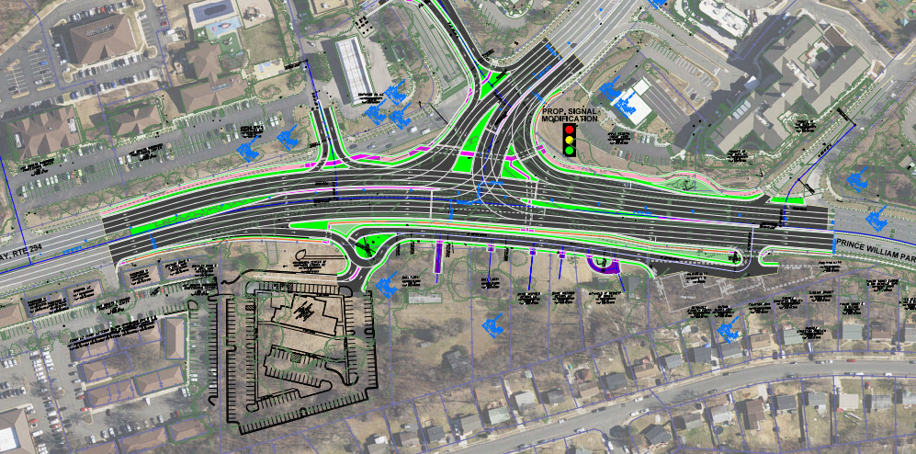
Mohammadia

